Slide 1
Problem Statement
Develop a GPS toll-based system simulation using Python.
Definetoll zones.
Register the car's start point when it passes through a toll zone and end point when it passes through another.
Calculate the distance traveled and toll amount.
Display the vehicle's path.

Slide 2
Unique Idea Brief (Solution)
Innovative simulation of toll calculation based on GPS tracking.
Real-time path tracking and toll calculation.
User-friendly interface showing vehicle path and toll information.
Flexible route options with service roads for enhanced simulation.

Slide 3
Features Offered
Real-time start and end point registration.
Dynamic toll zone detection.
Accurate distance calculation.
Automatic toll amount computation.
Visual representation of the vehicle’s path.

Slide 4
Process Flow
Start simulation.
Car travels through a selected route.
Detect passing through toll zones.
Register start and end points.
Calculate distance and toll amount.
Display path and toll details.

Slide 5
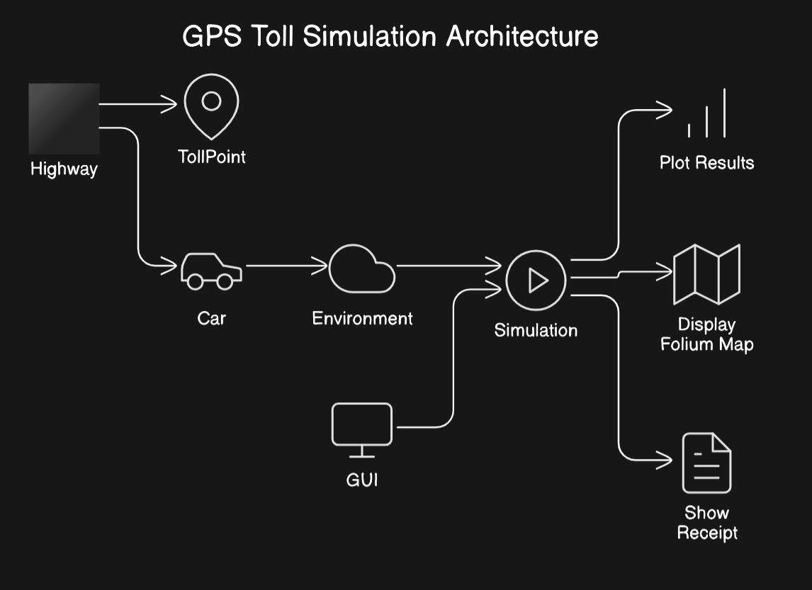
Architecture Diagram
Diagram illustrating the system architecture:

Slide 6
Technologies Used
GPS module for tracking.
Database (e.g., SQLite) for storing data.
Libraries: Geopy for distance calculation, Matplotlib for path visualization.
Python for simulation and calculations.
Frontend: Tkinter for GUI development.

Slide 7
Team Members and Contribution
Team Member 1: Project lead, backend development.
Team Member 2: GPS integration, distance calculation.
Team Member 3: Database management, toll calculation.
Team Member 4: Frontend development, GUI design.

Slide 8
Conclusion
Successful simulation of a GPS toll-based system.
Real-time tracking and toll calculation achieved.
Flexible route options enhance simulation realism.
Potential for real-world application and further development.

